Slide 1
Stone Villa Second Homeowners’ Association 2021 Annual Meeting
September 15, 2021

Slide 2
Zoom Meeting
Let’s do a quick “Technology Check” to ensure all Stone Villa Residents are able to attend if so desired.

Slide 3
Agenda
Board Introduction
HOA-Administrators Overview
2020-2021 Activities & Updates
Financial Review
Covenants / Bylaws Review
Land Development Update
Construction Update
Q3 & Q4 Projected Activities
Questions
End of Meeting

Slide 4
2021 HOA Board Introduction
Board Member | Role / Responsibility
Rich Sullivan | Chief Financial Officer / Financials
Noah Bleicher | Director of Operations / Communications
Brian Beam | Director of Development / Infrastructure
Sam Sullivan | HOA Administrators / Covenants
Noah, Brian, Rich | Architectural Committee

Slide 5
3rd Party HOA Manager Roles & Responsibilities
The HOA Board hires a 3rd party company (HOA Administrators) to serve as a point of contact for Homeowners and an execution arm for the Board. HOA Administrators is responsible for:
Financial and Accounting Services
Administrative Services
Property and Community Management
Covenant Supervision and Violation Management
Point of Contact for Homeowners
Initiated Services 10/2020 for 1-year Contract
HOA Administrators is the primary manager of the Stone Villa Second HOA on behalf of the Board

Slide 6
Point and Purpose of a HOA
The Home Owners’ Association (HOA) is a not-for-profit entity charged with financial stewardship and covenant administration on behalf of the Homeowners, among other responsibilities.
All HOAs have Community documents, known as CCR’s (Covenants, Conditions, & Restrictions). Think of these like the “rules of the road” for the neighborhood that dictate community standards and expectations of residents (and the Home Builder). They are filed with the County and are publicly available (and on the website).
One of the main responsibilities of an HOA is to protect the integrity and consistency of the Community by maintaining shared Common Areas and holding Homeowners accountable to the rules of the CCR’s.

Slide 7
Homeowner Correspondence
When the Board needs to communicate to the Homeowners at large, it will be via one of three ways:
Sent Electronically via the HOA Website (ex: Community Announcements)
Sent Electronically via Email (ex: Arch Committee Applications)
Sent “Snail Mail” via USPS (ex: Annual Dues or Meeting Notices)
The Stone Villa Second HOA Website is: www.StoneVillasHOA.com
The website is a resource for Community information, Utilities contacts, and HOA documents (DOD, CCRs, Financials)
It also has a Community Message Board for neighbors to ask questions, post notices, or make announcements

Slide 8
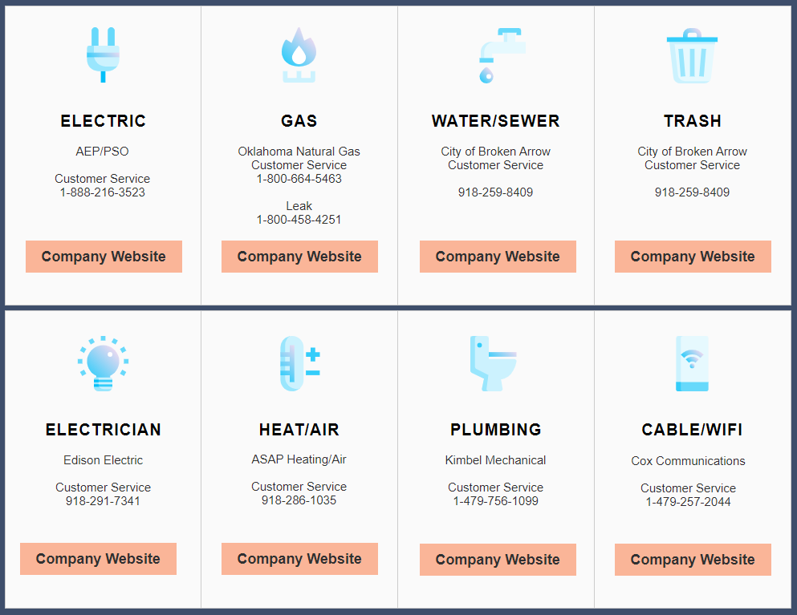
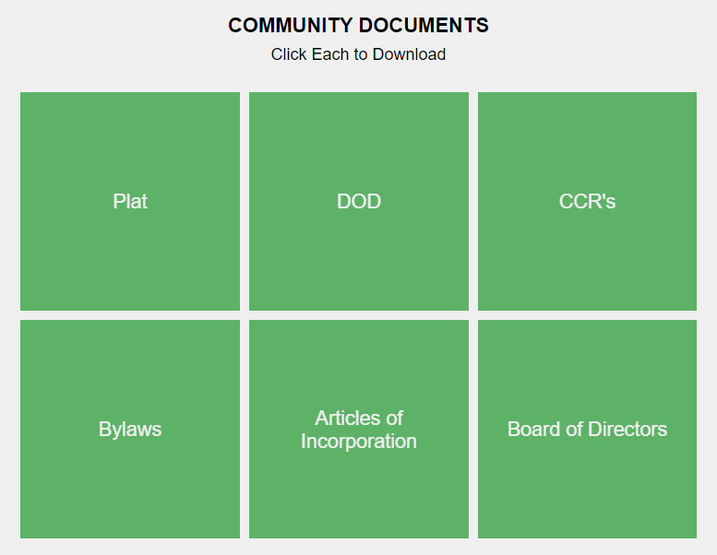
HOA Website
www.StoneVillasHOA.com
We encourage Homeowners to log on and create an account

Slide 9
Covenants, Conditions, & Restrictions (CCR’s)

Slide 10
What are HOA Covenants?
HOA Covenants are in place for the purpose of enhancing and protecting the value, desirability, and attractiveness of the Community as a whole and enhancing the quality of life within the Community
They specify Community rules for fences, outbuildings, pools, etc. and dictate requirements for Common Area Maintenance (CAM), among other things
The Covenants, Conditions, & Restrictions (CCR’s) were filed with Tulsa County on 1/31/2020 and are available on the Stone Villa HOA Website
Ultimately, they are in place to support the individual Homeowners’ quiet enjoyment of their home and to preserve the financial investment for each member of the Community

Slide 11
Covenant Administration
HOA Administrators performs MONTHLY neighborhood inspections looking for Covenant violations
If you suspect a potential Covenant Violation, please contact Sam Sullivan: sam@hoa-administrators.com
If you are unsure about what is allowed per the CCRs, please read the Community documents first before reaching out to Sam Sullivan (sam@hoa-administrators.com)

Slide 12
What is the HOA Board entrusted to do?
Maintain the Common Areas
Hold all Homeowners to the same set of rules (CCR’s)
Ensure Trailers / Boats / RV’s are not parked in driveways for extended periods of time
NOTE: These vehicles can be parked on property for a 48-hour period (unless given prior HOA consent)
Communicate with Homeowners and the Municipality (as needed)
Review applications for Fences / Sheds / Pools / etc. and provide either approval or guidance for improved applications

Slide 13
What is NOT within the scope of the HOA Board?
Common Issues NOT covered by Stone Villa CCR’s:
Speeding vehicles
Construction traffic/parking
Neighborhood roads and road maintenance
Police or Legal matters

Slide 14
Financials

Slide 15
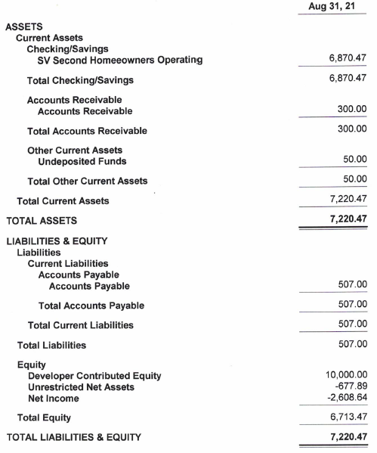
Financial Review – 2021 Balance Sheet (Aug YTD)
Dedicated HOA bank Account (August 2020)
Developer contributed $10k to HOA (seed $)
$~7k Cash in operating acct
87 lots in total

Slide 16
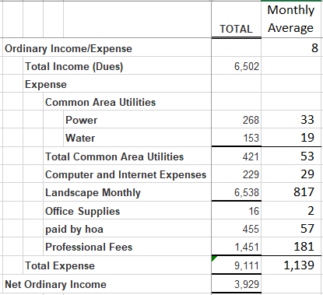
HOA Financials – 2021 August YTD Income Statement
Closed Homes
8 in 2020
13 in 2021 (so far)
10 more by YE (forecasting)
2021 Dues were billed in January 2021 ($300 per home)
Budget assumes all homeowners pay dues
0 currently outstanding
~$1,140 monthly burn rate
CHRG pays portion of dues
2021 Financials (June) are on SV HOA Website
HOA financials are in good shape given scope of services

Slide 17
Community Activity

Slide 18
2020 – 2021 Activity
Community established and first homes sold in 2020
19 homes sold so far as of August, 2021 (out of 87)
Phase II homes began selling Summer, 2021
Land Development activity will be completed around October, 2021

Slide 19
Construction Update
This is a Community with active Construction taking place. As such, some construction debris will be present. We appreciate your patience.
If any Construction-related Community issues to report (excessive debris, issues with your home, etc.) please report via Capital Homes Warranty website: https://www.capitalhomes.com/warranty

Slide 20
Questions from Homeowners

Slide 21
Meeting Adjourned And don’t forget to visit the Stone Villa HOA website! www.stonevillashoa.com

